Slide 1
FACTORY METHOD PATTERN

Slide 2
What is it?
Factory Method is a creational design pattern that provides an interface for creating objects in a superclass, but allows subclasses to alter the type of objects that will be created.
Instead of creating objects directly, we use a factory method to create and return them.

Slide 3
How Does it Work?
The Factory Method pattern consists of four main components:
Creator: This is the abstract class that defines the factory method and serves as a factory for creating objects. The factory method defines the way objects are created. The creator class may also contain other methods that work with the created object.
Concrete Creator(s): This is the sub class of the creator class that implements the factory method to create specific objects. Each concrete creator is responsible for creating a particular product.
Product: This is the interface or abstract class that defines the methods that the concrete product(s) must implement.
Concrete Product(s): This is sub class of the product class that implements the product interface. They are actual objects that the factory method creates through the concrete creators.

Slide 4
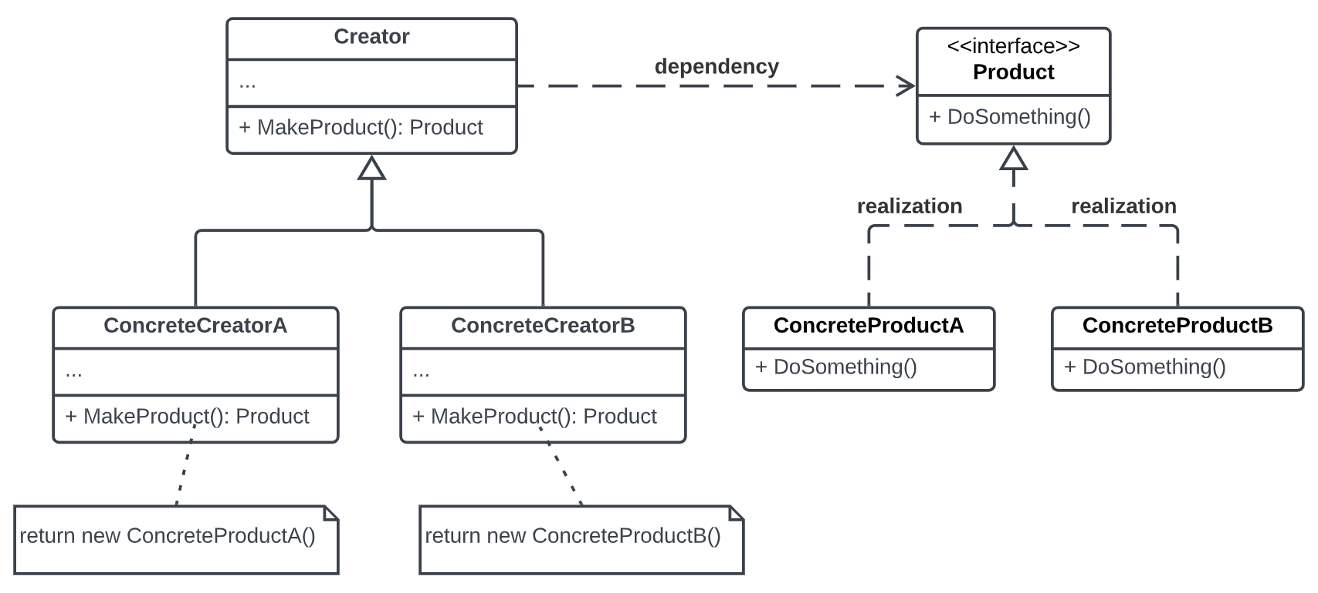
Class Diagram Illustration

Slide 5
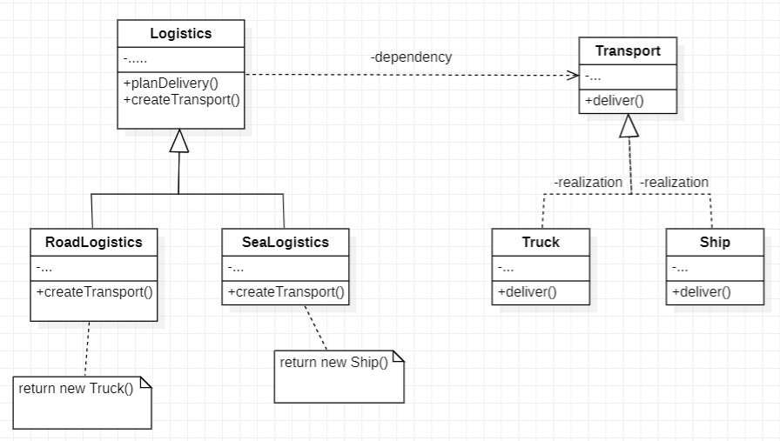
Example:
Both Truck and Ship classes should implement the Transport interface, which declares a method called deliver. Each class implements this method differently: trucks deliver cargo by land, ships deliver cargo by sea. The factory method in the RoadLogistics class returns truck objects, whereas the factory method in the SeaLogistics class returns ship objects.

Slide 6
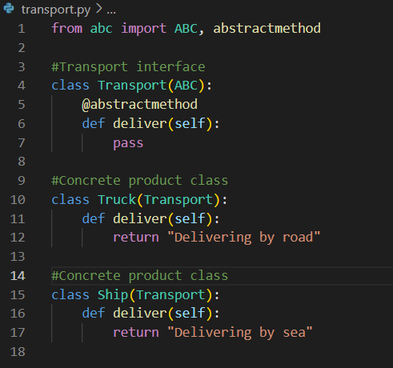
Code Example:
Product and Concrete Product Classes

Slide 7
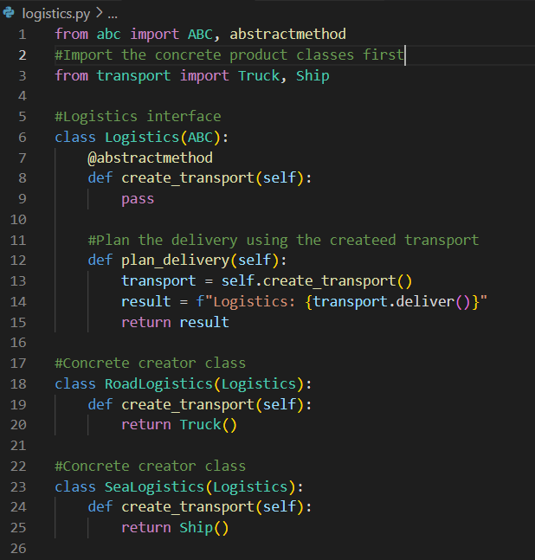
Creator and Concrete Creator Classes

Slide 8
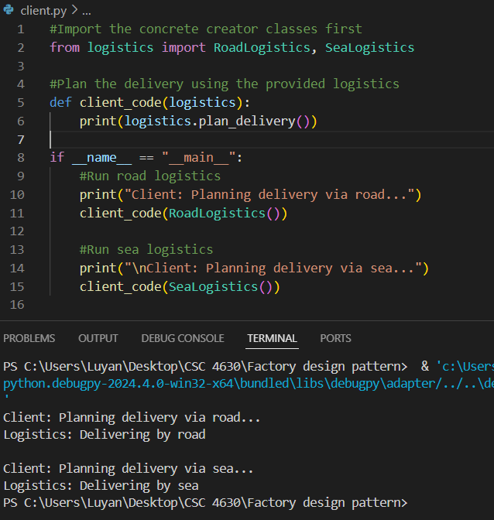
When we run it

Slide 9
When Can We Use it?
The Factory Method pattern is useful when:
We want to encapsulate the object creation process: If you have a complex object creation process or if the process may vary based on conditions, encapsulating this logic in a factory method can simplify client code and promote reusability.
We want to promote loose coupling between classes: The Factory Design Pattern helps promote loose coupling by separating the concrete product creation from the creator (factory) interface. Concrete creators are responsible for instantiating concrete products, shielding the client (creator) from the details of object creation. This separation reduces dependencies between the concrete creators and concrete products, as well as between concrete creators and the creator. Changes in concrete products or concrete creators do not affect the creator as long as the creator interface remains consistent.
We want to promote code reuse: The Factory Design Pattern encourages code reuse by centralizing the object creation logic within the factories. Instead of duplicating this logic across multiple places in the codebase, it's encapsulated within the factories. When you need to create instances of a particular class in multiple parts of the system, using a factory allows you to reuse the same instantiation logic. This avoids redundancy and promotes consistency.

